Slide 1

IEEE IC Hack 2.0
Advancement In Healthcare

Slide 2


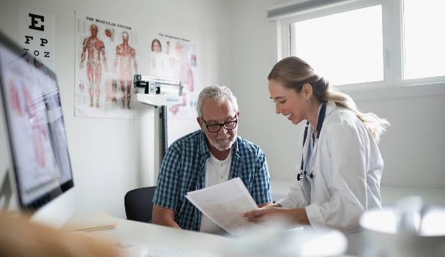
Introduction Creating a unified patient treatment platform for healthcare advancement involves integrating various aspects of patient care, data management, TRANSPORTAION, communication, and decision-making to enhance the overall healthcare experience.

Slide 3

Developing an Unified Patient Treatment Platform for Healthcare Advancement(UPTP)
IDEA OVERVIEW
SOLUTION: We are going to make an Android app which will contain 3 layout page
Medicine suggested for a particular disease by knowing the symptoms, and allergy.
Suggestions of doctors by means of appointment.
Booking the slot for bed in hospital and call for the immediate Ambulance.

Slide 4

Medicines suggested for a particular disease by knowing the symptoms and the patient’s allergy
Our android app has one layout which will suggest the medicine by knowing the symptoms through check box.
They can access the scanning option for verify the medicines for the disease.
We also suggest the food which the patient have to intake.
It will suggest the good life style options.

Slide 5

Suggestions of doctors by means of appointment.
This layout will connect the patient with the doctor, through video consultation.
Also by knowing the symptoms of the patient this layout can suggest to connect with the doctor.

Slide 6
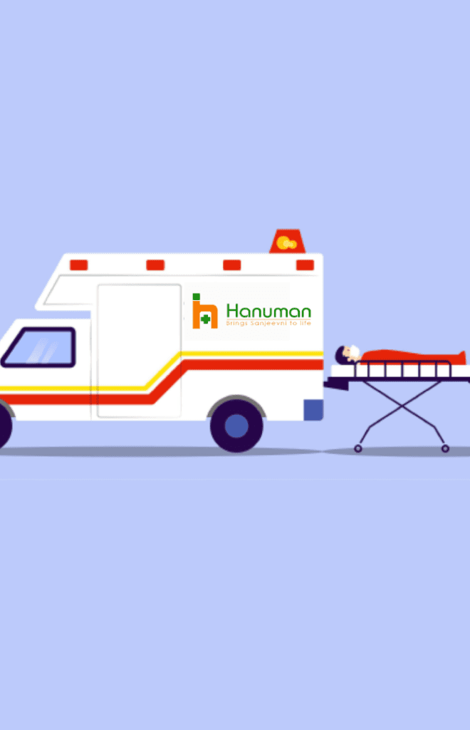
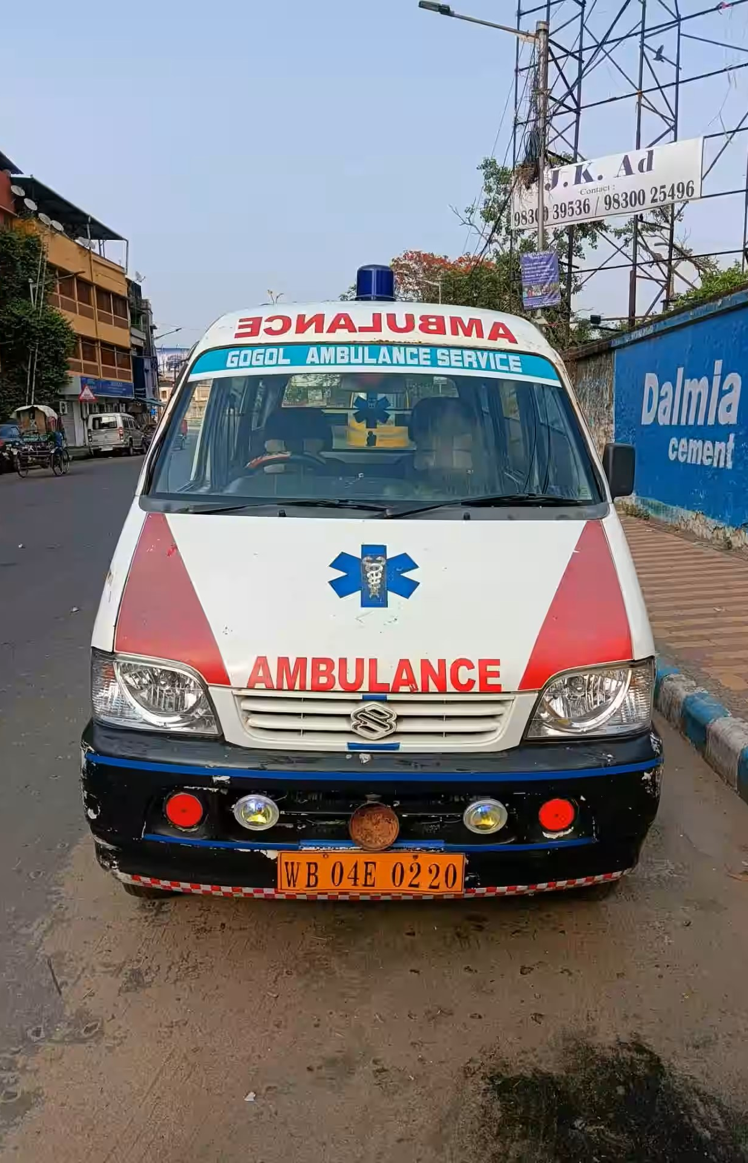
Ambulance services:
we will collect the data from the user of the application.
If some emergency case happens then we are going to provide them on-site doctor consultation from the nearest hospital.
If not emergency case takes place then we will take the patient to nearest hospital.

Slide 7
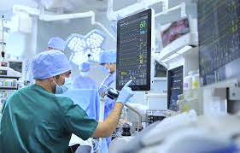
Market prospects
Marketing plays a crucial role in the healthcare industry, as it helps healthcare organisations and practitioners promote their services and products. The role of marketing in healthcare is not just limited to promoting services and products; it also includes creating brand awareness, building relationships with patients and stakeholders, and maintaining a positive image in the community.The International Institute of Health Management and Research (IIHMR), Delhi offers several courses in healthcare management, including a PGDM (MBA equivalent) in hospital management, a PGDM (MBA equivalent) in health management, a PGDM (MBA equivalent) in health information technology, and more. These courses aim to provide students with the necessary knowledge and skills required to manage healthcare organisations effectively. Healthcare marketing is an essential aspect of these courses, as it helps students understand the importance of marketing in the healthcare industry.

Slide 8
Future scope
The future scope of a Unified Patient Treatment Platform is dynamic and depends on advancements in technology, healthcare policies, and the evolving needs of patients and healthcare providers. Continuous innovation and a focus on improving patient outcomes will be essential for its long-term success.
Continuous Improvement and User Feedback:
Establish mechanisms for continuous improvement based on user feedback from healthcare providers, patients, and other stakeholders.
Regularly update the platform to incorporate the latest advancements in technology and healthcare practices.

Slide 9
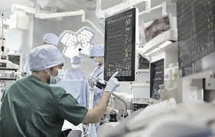
Technical overview
Developing a Unified Patient Treatment Platform (UPTP) for healthcare advancement involves integrating various technical components to streamline and enhance patient care. Here's a high-level technical overview:
Data Integration: Electronic Health Records (EHR): Integrate and aggregate patient data from diverse sources, including EHR systems, diagnostic devices, and wearables.
Interoperability Standards: Implement standards like HL7 and FHIR to ensure seamless data exchange between different healthcare systems.
Data Analytics and AI: Predictive Analytics: Employ machine learning algorithms to analyze historical patient data, aiding in the prediction of potential health issues and optimizing treatment plans.
Telemedicine Integration: Video Conferencing: Integrate telemedicine features for remote consultations, enabling healthcare providers to connect with patients virtually. Remote Monitoring: Include tools for monitoring patients' vital signs and health metrics remotely.
Mobile Application: Patient Engagement: Develop a user-friendly mobile app to empower patients with access to their health records, appointment scheduling, and personalized health information.

Slide 10




Summary
Creating a Unified Patient Treatment Platform (UPTP) involves integrating patient data from diverse sources into a secure cloud infrastructure. Utilizing AI and machine learning, the platform provides predictive analytics and decision support for healthcare professionals. Telemedicine features and a user-friendly mobile app enhance patient engagement, while blockchain ensures data security. Regulatory compliance and continuous improvement through feedback drive the UPTP's evolution, with the ultimate aim of advancing healthcare through innovation and efficiency.

Slide 11

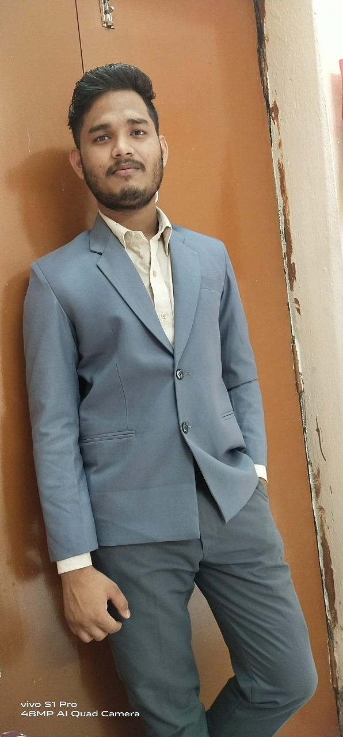
Team Members
Name: Akanksha Patnaik
3rd year ETC
Name: Soumya Ranjan Pradhan
3rd year ETC

Slide 12

Thank you
Presenter name : Akanksha Patnaik
:Soumya Ranjan Pradhan
Email address: akpatnaik2002@gmail.com

